Slide 1
Using a Travelling Salesman Algorithm to Minimize Hallway Traffic
Ian Hay
Notes:
Hello, my name is Ian, and I am a senior at Conestoga High School.
Traffic, regardless of location, is a hassle and inefficient
Reduction of traffic can make our society more efficient and give us more time in every day to do meaningful tasks

Slide 2
Background
Conestoga High School student body growing
Reached 2,200 students
Notes:
Population of Conestoga growing to largest size
4-5 minutes between classes to get to class, still not enough in certain scenarios
Current potential solution for this problem is to make a new wing for the school to allow another avenue for traffic passthrough

Slide 3
To What Extent Can Computer Programming Minimize Hallway Traffic?
Graduate students at MIT coded a bus-routing algorithm to optimize Boston’s school bus system
Eliminated 50 bus routes, saving $3-5 million per year
Notes:
Use computer programming to try and rework the schedules to minimize distance travelled
Has been done to an extent in Boston with computer science graduate students at MIT for the Boston school system
Had serious implications to the budget of the boston school system

Slide 4
Travelling Salesman Problem
No definite solution/algorithm
N! Possible routes to test
Heuristic algorithms
Notes:
Algorithm used to tackle problems related to finding the shortest path to a set of points
Many different algorithms that can be used, each of them have different benefits and drawbacks
This problem has N! Possible routes for a set of N points
For a single schedule, that is 40,320

Slide 5
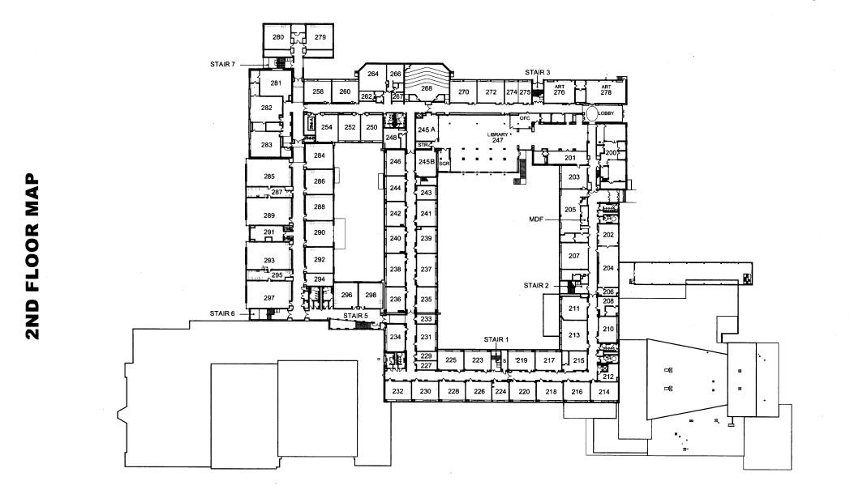
A* Pathfinding Algorithm

Slide 6
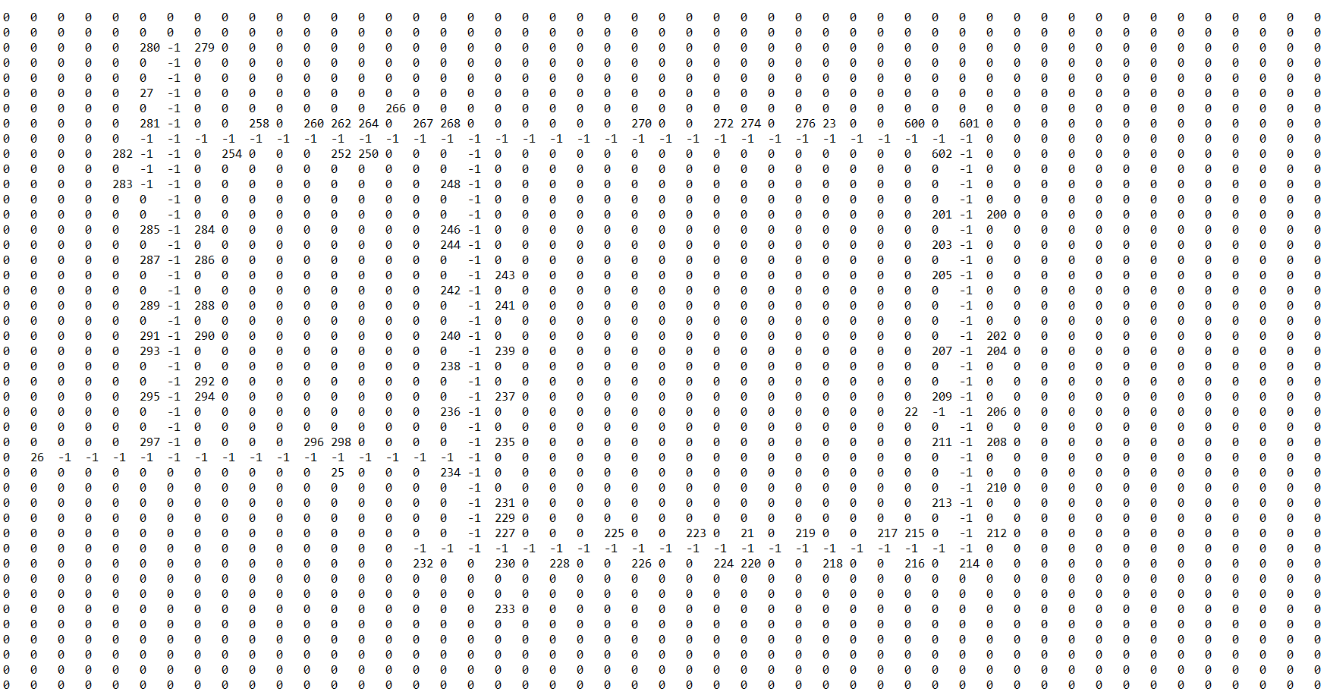
A* Pathfinding Algorithm
Notes:
Pathfinding algorithm for finding the path and distance between two points given the possible routes available
NEcessary for my project because Students and factulty must walk to class along the hallways, they cant travel directly from class to class through the walls
Manually scored a map of the school and inputted it in to my code

Slide 7
Methodology
Combination of A* Algorithm and Travelling Salesman Algorithm
Coded both in to Java
Coded in grid to represent the school
Notes:
Coded in both the pathfinding and the travelling salesman algorithms for use in my project
For the travelling salesman algorithm, I chose an algorithm that sacrifices some accuracy for speed, allowing it to potentially be run for 2,200 students in a relatively short amount of time
I scored and coded in a grid, as seen on the right
Zero’s represent walls / impassable objects
-1’s are hallways
11-19 are staircases
Everything else is a room number, with any number over 300 corresponding to a “special” room (e.g. Gym becomes 302)

Slide 8
Implementation
Stratified random sample of 20 current student schedules
Recorded total distance before and after algorithm
Notes:
Split up the code in to three different classes
Theoretically, this code can be used for any school or really any building as long as you code in a new map of the school/building
// not sure if i want to leave this slide in after explaining most of the methodology in the previous slide but oh well. Might include snippets of code to use as examples. LMK

Slide 9
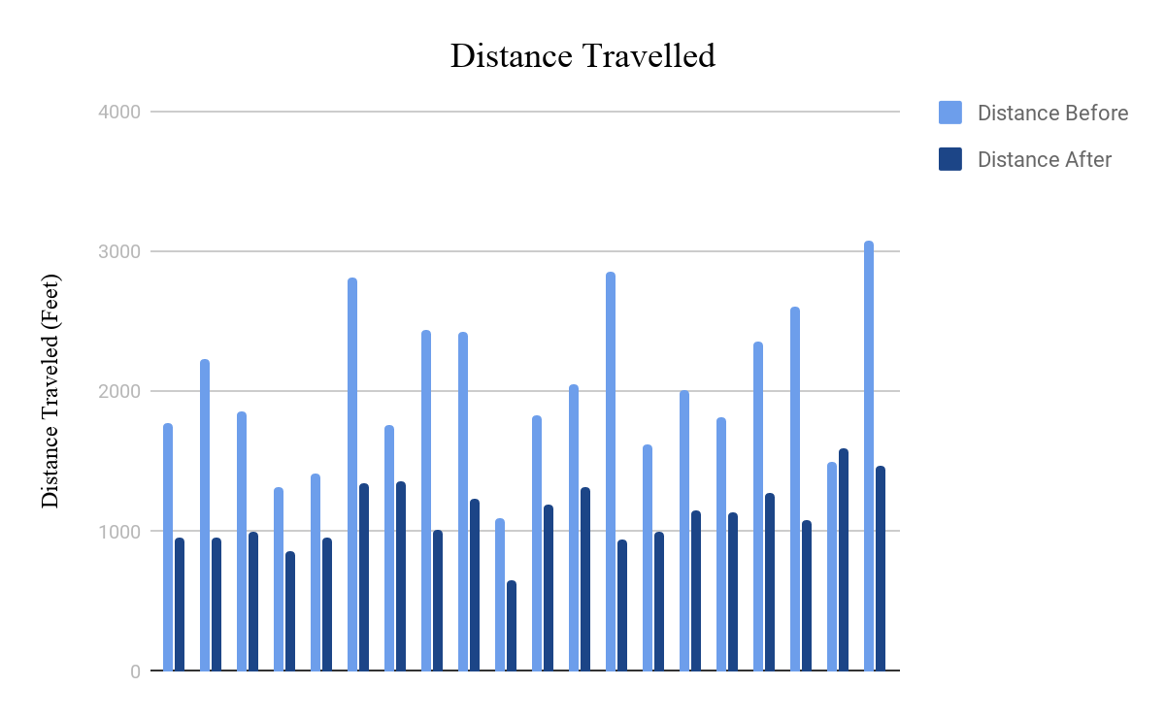
Results
Notes:
Using the program on a random sample of 20 student schedules, stratified by grade level and provided by the school administration, I generated these results. Across the board, you can see that the program decreased the distance travelled by each student by 40% on average. One key point to note is the second point from the right. In this situation, the heuristic travelling salesman algorithm actually increased the distance travelled with that particular schedule. This is completely normal and not some anomaly against mathematics. The heuristic is only good enough to produce a result that is about 60-70% as efficient as the true best answer. It simply occurred by chance that the original schedule was more efficient than the heuristically generated schedule.

Slide 10
Implications
Assumed best case scenario
Plausible, not necessarily this extreme
Reduction of traffic by on average ~40%
Useful to find the best class schedule among a selection of pre-made schedules
Notes:
My results represented the best case scenario for the scheduling system. These assumptions include assuming that classes were taught in their room for all 8 periods of the day, allowing the algorithm to place classes at any period in the day without worry for class availability. While this assumption is not safe for use in the real world, it not only made the program much faster but also fit my research question of finding the fullest extent that a program like this could reduce hallway traffic. In addition, the A-Star algorithm used in this program is useful for finding the distance travelled by possible schedules determined by the current school’s system. For instance, the school could find all of the potential schedules for an applicable student and use this algorithm to find the distance travelled by each of them, picking the schedule with the least distance travelled. While this system would not reach the same results displayed here, the application of this method would be possible in the real world very seamlessly and could be an avenue for future research.

Slide 11
Limitations
Assumed students took the shortest path between classes
No check for class sizes or number of classes/labs available
Notes:
Some limitations to the results I reached include the “best case scenario” assumptions I mentioned earlier. I assumed that students would take the shortest path in between classes, which is not necessarily the case but is a fair enough assumption to make. Also, the program did not check for class sizes/availability or class compatibility at all. In other words, it never checked to see if the same room was hosting two different classes at the same time. While I was looking for the fullest extent that this program could reduce hallway traffic, it is still noteworthy to say that a program with these parameters in check would provide a more realistic estimate as to how a program like this would impact the real world traffic.

Slide 12
Further Research
Extent and plausibility of a more complex program that uses conditions
Runtime of algorithm as conditions are added
Notes:
In addition to a program that takes in to account the conditions and limitations of the school system, there are other possibilities for additional research. One potential

